Slide 1
Industry Theme: Business
Online Bookstore Database
Alternative Assessment 1- Database WIA2001
Amir Firdaus Bin Abdul Hadi
17204620/2

Slide 2
Database Design Process
Defining database objective
Mapping business rules
Creating data models ERD
Identify user and stakeholders
Defining user data requirements
Notes:
To store data about available books to sell and its customer for an online bookstore business.
User: customer, author, publisher, business owner,

Slide 3
Business Rules
01
One customer can buy many books
04
One customer must have at least one address and one payment information.
02
One book can have many authors
05
One customer can put many orders in one order cart.
03
One publisher can publish many books
06
Eachbooks have its own category and ratings.

Slide 4
Entity Relationship Diagram ERD
Tables and attributes
book (bookID, languageID, categoryID, bookTitle, bookPages, bookISBN, publisherID, publishDate, starRateID, bookPrice)
book_language (languageID, languageName)
book_category (categoryID, categoryName)
book_rate (starRateID, starDescription)
book_author (bookID, authorID)
author (authorID, authorName, authorEmail)
publisher (publisherID, publisherName, publisherAddress, publisherEmail)
customer (customerID, customerName, customerEmail, customerContact)
customer_address (addressID, customerID, streetNo, streetName, city, country_id)
country (countryID, countryName)
customer_card (cardID, customerID, cardName, cardNumber)
order (orderID, bookID, quantity)
order_cart (cartID, orderDate, customerID, addressID, totalPrice)
order_history(historyID, cartID, statusID)
order_status (statusID, statusDescription, statusDate)

Slide 5
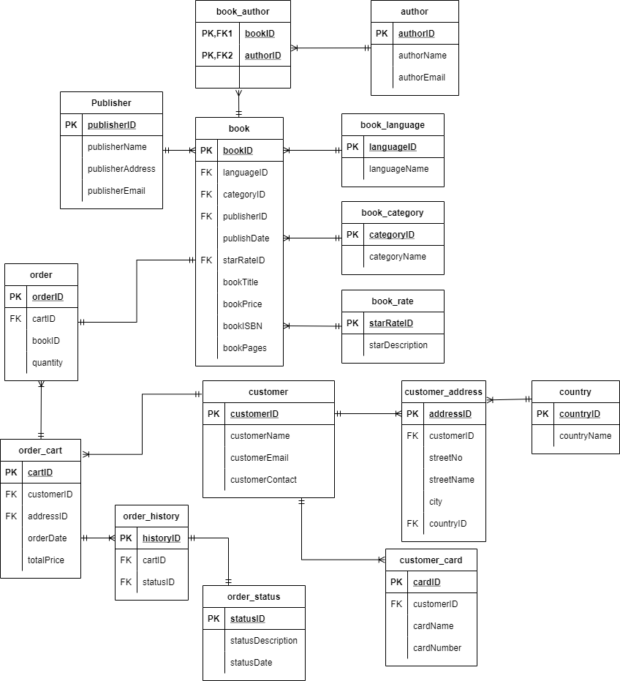
Entity Relationship Diagram ERD

Slide 6
Sample SQL Queries
01
SELECT book.bookTitle, book.bookPrice, book_rate.starDescription
FROM book JOIN book_rate
ON book.starRateID = book_rate.starRateID
WHERE starRateID >= 4;
Display book title, its price and ratings where the rating is 4 and above.
02
SELECT book.bookTitle, book.bookPages,
FROM book JOIN book_category ON book.categoryID = category.categoryID
WHERE category.categoryName ='Mystery' AND book.bookPages > 100;
Display all book title under ‘Mystery’ category and pages more than 100 pages.
03
SELECT customer.customerName, customer.customerEmail
FROM customer JOIN order_cart
ON customer.customerID = order_cart.customerID
WHERE order_cart.totalPrice >= 300;
Display customer name and email that bought books with a total exceeding RM300.

Slide 7
Thanks!

